Slide 1
Router Architecture

Slide 2
Outline
Overview
Switching Fabrics
Buffering Approaches
Throughput Performance
Scheduling

Slide 3
Router architecture overview
high-level view of generic router architecture:
routing, management
control plane (software)
operates in millisecond
time frame
routing
processor
forwarding data plane (hardware) operates in nanosecond timeframe
high-speed
switching
fabric
router input ports
router output ports

Slide 4
Input port functions
lookup,
forwarding
queueing
line
termination
link
layer
protocol
(receive)
switch
fabric
physical layer:
bit-level reception
data link layer:
e.g., Ethernet
see chapter 5
decentralized switching:
using header field values, lookup output port using forwarding table in input port memory (“match plus action”)
goal: complete input port processing at ‘line speed’
queuing: if datagrams arrive faster than forwarding rate into switch fabric

Slide 5
Input port functions
lookup,
forwarding
queueing
line
termination
link
layer
protocol
(receive)
switch
fabric
physical layer:
bit-level reception
decentralized switching:
using header field values, lookup output port using forwarding table in input port memory (“match plus action”)
destination-based forwarding: forward based only on destination IP address (traditional)
generalized forwarding: forward based on any set of header field values
data link layer:
e.g., Ethernet
see chapter 5

Slide 6
Destination-based forwarding
longest prefix matching
when looking for forwarding table entry for given destination address, use longest address prefix that matches destination address.
Destination Address Range
11001000 00010111 00010*** *********
11001000 00010111 00011000 *********
11001000 00010111 00011*** *********
otherwise
Link interface
0
1
2
3
examples:
DA: 11001000 00010111 00010110 10100001
which interface?
DA: 11001000 00010111 00011000 10101010
which interface?

Slide 7
Longest prefix matching
longest prefix matching: often performed using ternary content addressable memories (TCAMs)
content addressable: present address to TCAM: retrieve address in one clock cycle, regardless of table size
Cisco Catalyst: can hold upwards ~1M routing table entries in TCAM

Slide 8
Outline
Overview
Switching Fabrics
Buffering Approaches
Throughput Performance
Scheduling

Slide 9
Switching fabrics
transfer packet from input buffer to appropriate output buffer
three types of switching fabrics
memory
space division
switches:
eg, crossbar
memory
bus
Note: throughout this topic, the terms datagram and packet are used interchangeably. Also, when a datagram is assumed to have constant size, it is referred to as a cell

Slide 10
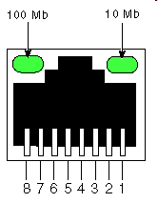
Switching via memory
first generation routers:
traditional computers with switching under direct control of CPU
datagram copied to system’s memory
speed limited by memory bandwidth (2 bus crossings per datagram)
input
port
(e.g.,
Ethernet)
output
port
(e.g.,
Ethernet)
memory
system bus
Let the input line rate be L cells/sec
Datagrams form all N input lines must be read in, and then read out and distributed over the N output lines
So, the aggregate throughput is LN cells/sec, and the fabric must switch at 2LN cells/sec
For a 2.5 Gb/s line rate, and 53-byte cells, the cell interval is 170 ns . For an 8x8 switch, 16 cells are switched within each cell interval => can only have about 10 ns for writing/reading a cell to/from memory
speed limited by memory bandwidth available commercially

Slide 11
Switching via a bus
datagram from input port memory to output port memory via a shared bus
The bus needs to handle LN datagrams/sec
bus contention: switching speed limited by bus bandwidth
32 Gbps bus, Cisco 5600: sufficient speed for access and enterprise routers
bus

Slide 12
Space-division Switches
overcome bus bandwidth limitations
variety of architectures: crossbar, Banyan networks, or other interconnection networks initially developed to connect processors in multiprocessor systems
advanced design: fragmenting datagram into fixed length cells, switch cells through the fabric
Cisco 12000: switches 60 Gbps through the interconnection network

Slide 13
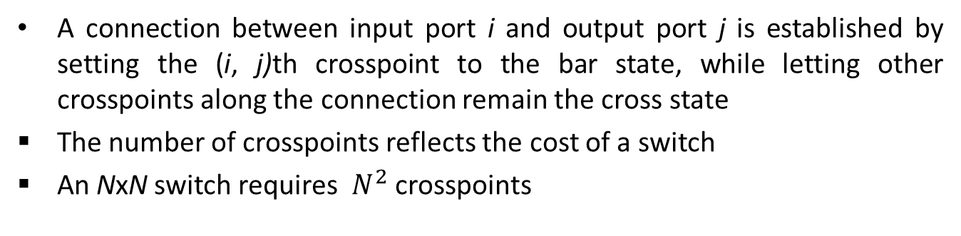
Crossbar Switch
A connection between input port i and output port j is established by setting the (i, j)th crosspoint to the bar state, while letting other crosspoints along the connection remain the cross state
The number of crosspoints reflects the cost of a switch
An NxN switch requires $N^{2}$ crosspoints

Slide 14
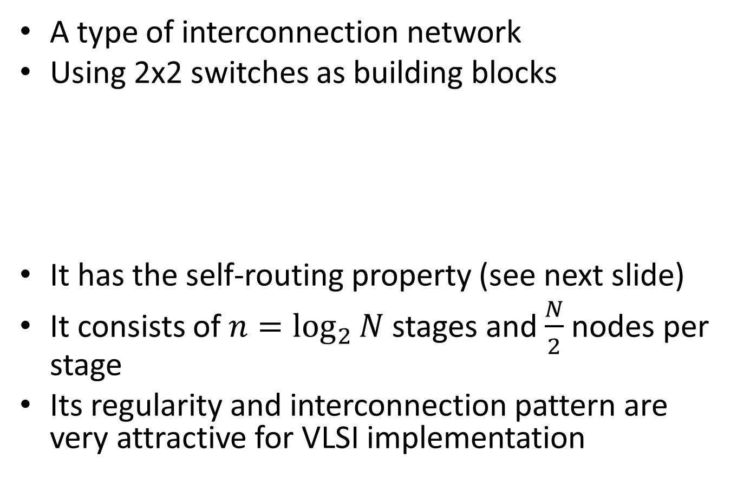
Banyan Switch
A type of interconnection network
Using 2x2 switches as building blocks
It has the self-routing property (see next slide)
It consists of $n=\log_{2}{N}$ stages and $\frac{N}{2}$ nodes per stage
Its regularity and interconnection pattern are very attractive for VLSI implementation
0
0
1

Slide 15
An 8x8 Banyan Switch
the unique 3-bit destination address can be used to route a cell from any input to any output.
the most significant bit is used in stage 1, etc…

Slide 16
Equivalent Topologies
The above equivalent topologies also belong to the Banyan class of self-routing switches

Slide 17
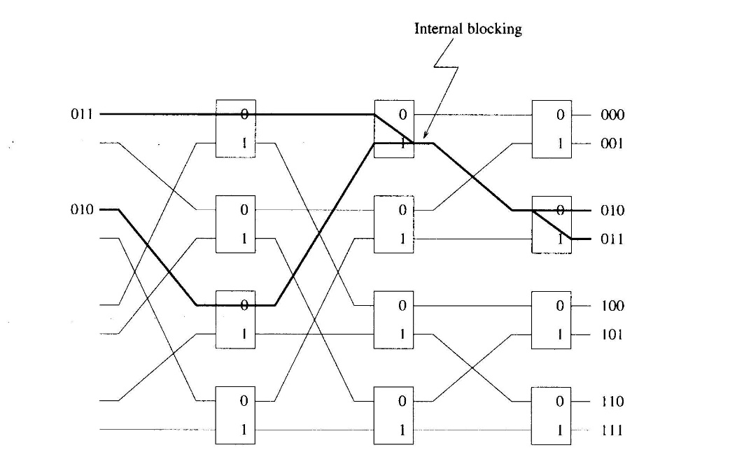
Internal Blocking
when there is contention on a link inside the switching fabric, a cell is lost

Slide 18
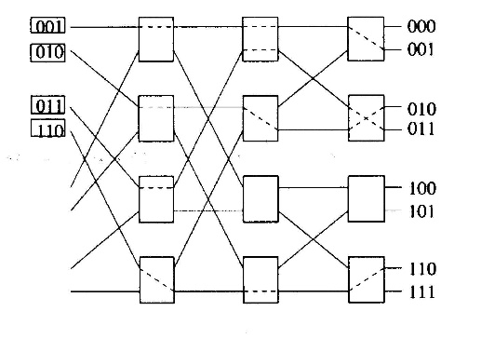
Avoiding Internal Blocking
A Banyan switch is internally non-blocking if both following conditions are satisfied:
there is no idle input between any two active inputs
the output addresses of the cells are in either ascending order or descending order

Slide 19
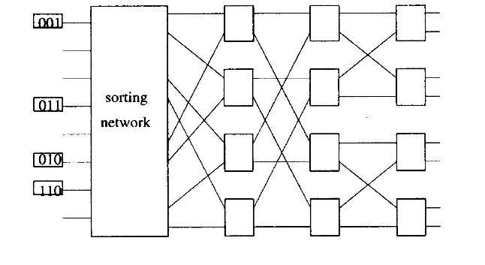
sort-Banyan Network
Suppose the banyan network is preceded by a network that concentrates the cells and sorts the cells according to their output destinations
The overall sort-banyan network will be internally non-blocking

Slide 20
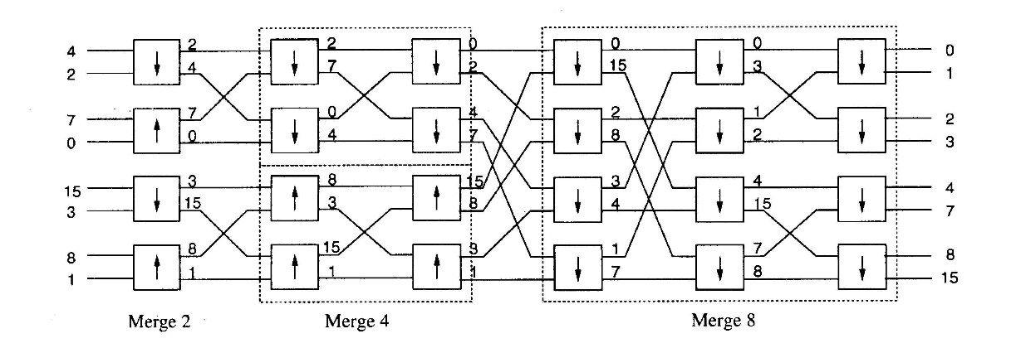
Batcher-Sorting Network
It is a sorting network formed by a series of merge networks of different sizes
A merge network is built from 2x2 sorting elements in stages, with connection pattern same as a Banyan network

Slide 21
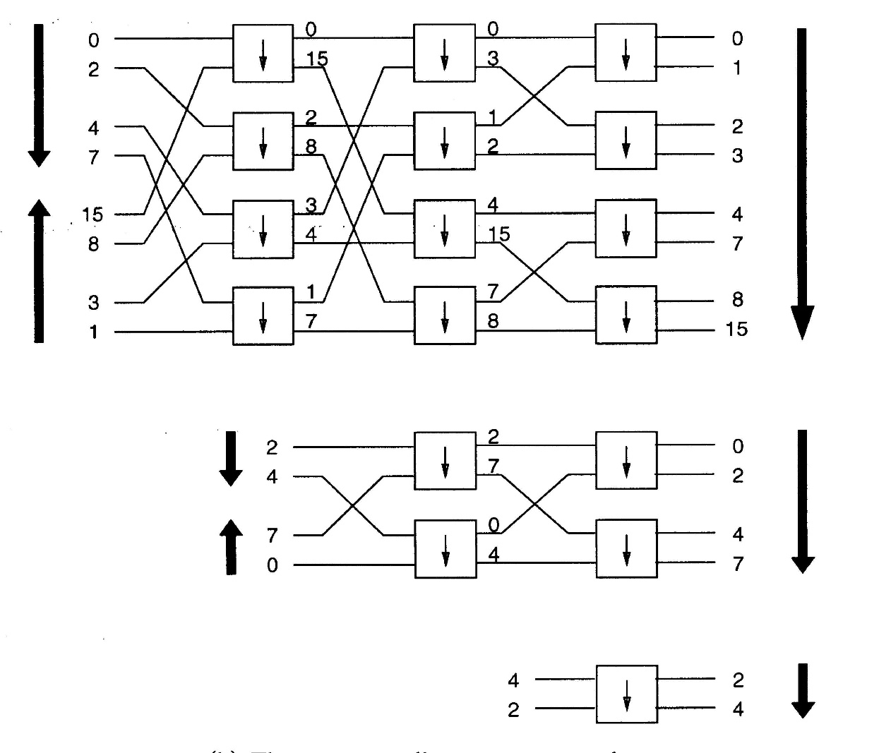
Basic structure of a Batcher-Sorting Network
if the order of the destinations of the first half input cells is ascending and that of the second half is descending, then the merge network will sort the cells into an ascending list at the outputs

Slide 22
Outline
Overview
Switching Fabrics
Buffering Approaches
Throughput Performance
Scheduling

Slide 23
Output Port Contention
Output port contention occurs when two or more cells arrive from different input ports and are destined for the same output port
A single output port can transmit only one cell in a time slot; thus the other cells must be either discarded or buffered.

Slide 24
Input Buffered Switches
buffers are placed in each input port
queueing delay and loss due to input buffer overflow!
suffer from head-of-the-Line (HOL) blocking (see next slide)

Slide 25
Head-of-the-Line (HOL) blocking
switch
fabric
switch
fabric
output port contention:
only one red datagram can be transferred. lower red packet is blocked
one packet time later: lower red packet is transferred, so green packet experiences HOL blocking
queued datagram at front of queue prevents others in queue from moving forward

Slide 26
Handling HOL blocking
If the fabric speed is increased, more cells can be switched to any one output in a cell interval, HOL blocking can be alleviated
For an NxN switch, fabric speed = N x line speed can eliminate HOL blocking
With more than one cell switched to a given output in a cell interval, buffers are required at the output port, leading to output port queueing

Slide 27
Output-buffered Switches
allows all incoming cells to arrive at the output port
Since there is no HOL blocking, the switch can achieve 100% throughput
queueing (delay) and loss due to output port buffer overflow!

Slide 28
Outline
Overview
Switching Fabrics
Buffering Approaches
Throughput Performance
Scheduling

Slide 29
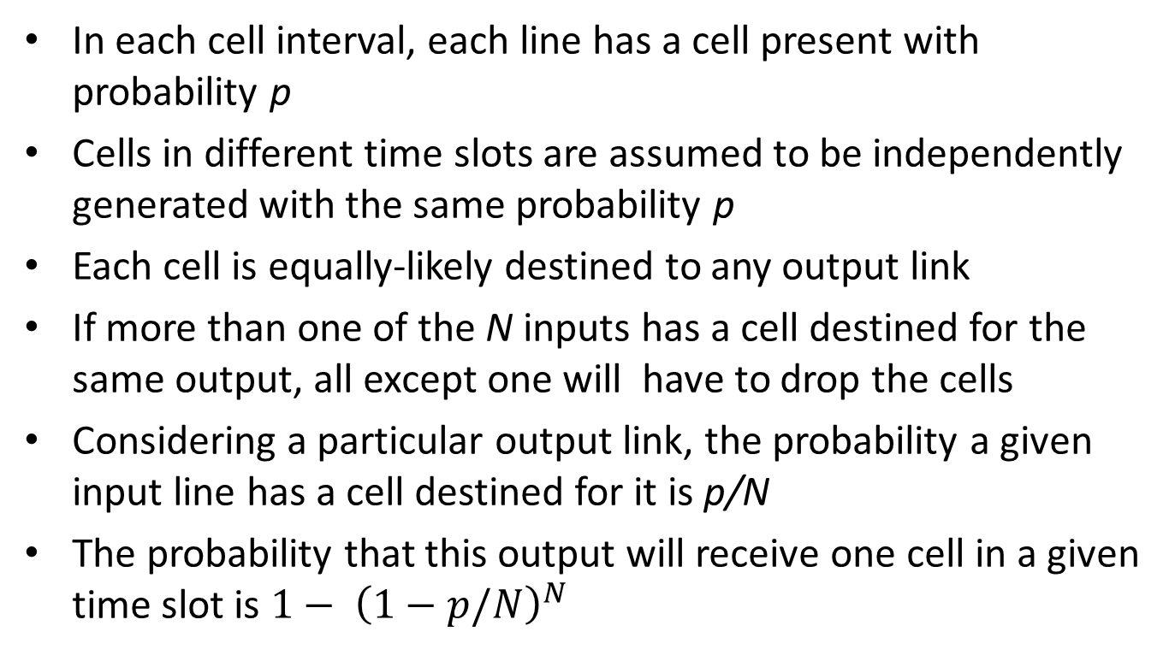
Throughput of Nonbuffered Crossbar Switch
In each cell interval, each line has a cell present with probability p
Cells in different time slots are assumed to be independently generated with the same probability p
Each cell is equally-likely destined to any output link
If more than one of the N inputs has a cell destined for the same output, all except one will have to drop the cells
Considering a particular output link, the probability a given input line has a cell destined for it is p/N
The probability that this output will receive one cell in a given time slot is $1− {\left(1−p/N\right)}^{N}$

Slide 30
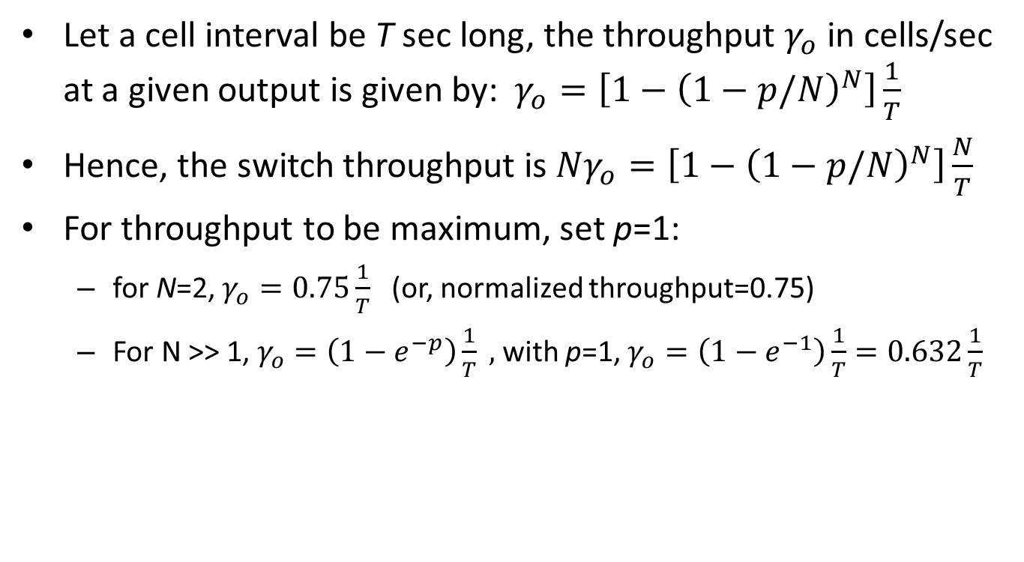
Let a cell interval be T sec long, the throughput $γ_{o}$ in cells/sec at a given output is given by: $γ_{o}=\left[{1−\left(1−p/N\right)}^{N}\right]\frac{1}{T}$
Hence, the switch throughput is ${Nγ}_{o}=\left[{1−\left(1−p/N\right)}^{N}\right]\frac{N}{T}$
For throughput to be maximum, set p=1:
for N=2, $γ_{o}=0.75\frac{1}{T}$ (or, normalized throughput=0.75)
For N >> 1, $γ_{o}=\left(1−e^{−p}\right)\frac{1}{T} ,$with p=1, $γ_{o}=\left(1−e^{−1}\right)\frac{1}{T}=0.632\frac{1}{T}$

Slide 31
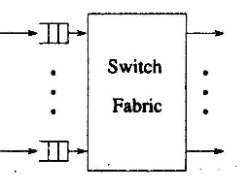
Throughput of Input-buffered Switch
Time is slotted in the size of a cell transmission time
If there are more than one cell contending the same output, only one of them is allowed to pass through the switch and the others have to wait until the next time slot

Slide 32
Assuming that all the input queues are saturated, i.e., there are always cells waiting in each input buffer, and whenever a cell is transmitted through the switch, a new cell immediately replaces it at the head of the input queue
If there are k cells waiting at the heads of input queues addressed to the same output, one of them will be selected at random to pass through the switch. In other words, each of the HOL cells has equal probability 1/k of being selected

Slide 33
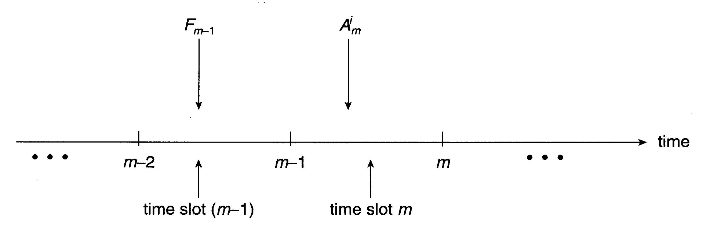
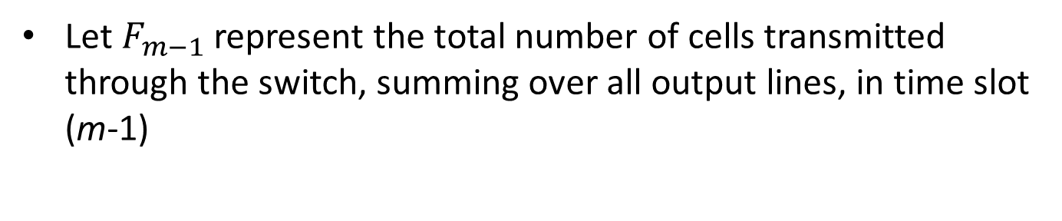
Let $F_{m−1}$ represent the total number of cells transmitted through the switch, summing over all output lines, in time slot (m-1)

Slide 34
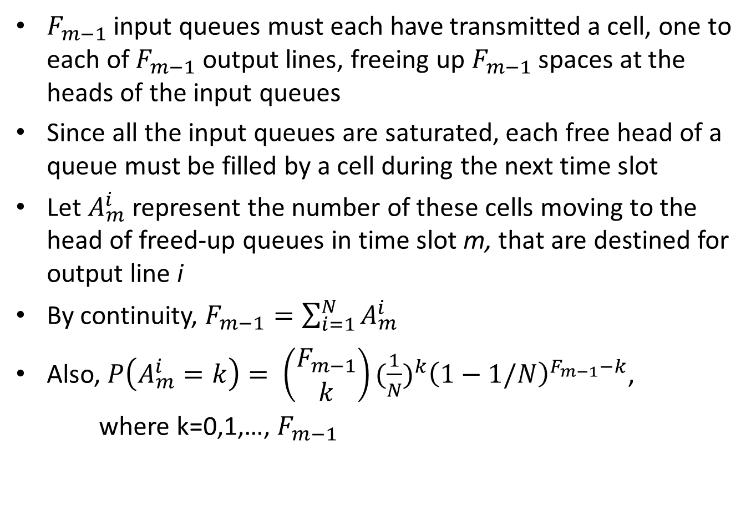
$F_{m−1}$ input queues must each have transmitted a cell, one to each of $F_{m−1}$ output lines, freeing up $F_{m−1}$ spaces at the heads of the input queues
Since all the input queues are saturated, each free head of a queue must be filled by a cell during the next time slot
Let $A_{m}^{i}$ represent the number of these cells moving to the head of freed-up queues in time slot m, that are destined for output line i
By continuity, $F_{m−1}=\sum_{i=1}^{N}{A_{m}^{i}}$
Also, $P\left(A_{m}^{i}=k\right)= \left(\begin{matrix}F_{m−1} \\ k\end{matrix}\right){(\frac{1}{N})}^{k}{\left(1−1/N\right)}^{F_{m−1}−k}$,
where k=0,1,…, $F_{m−1}$

Slide 35
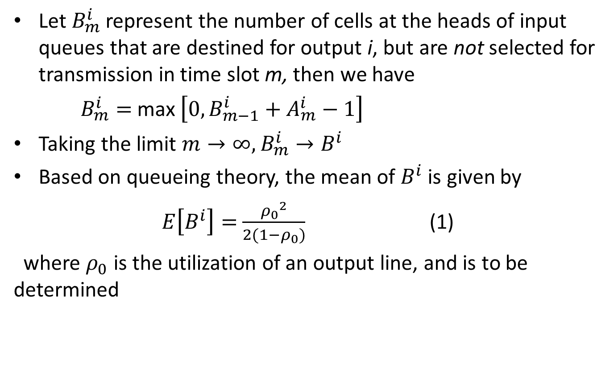
Let $B_{m}^{i}$ represent the number of cells at the heads of input queues that are destined for output i, but are not selected for transmission in time slot m, then we have
$B_{m}^{i}=$ max $\left[0, B_{m−1}^{i}+A_{m}^{i}−1\right]$
Taking the limit $m→∞,$ $B_{m}^{i}→B^{i}$
Based on queueing theory, the mean of $B^{i}$ is given by
$E\left[B^{i}\right]=$ $\frac{{ρ_{0}}^{2}}{2(1−ρ_{0})}$ (1)
where $ρ_{0}$ is the utilization of an output line, and is to be determined

Slide 36
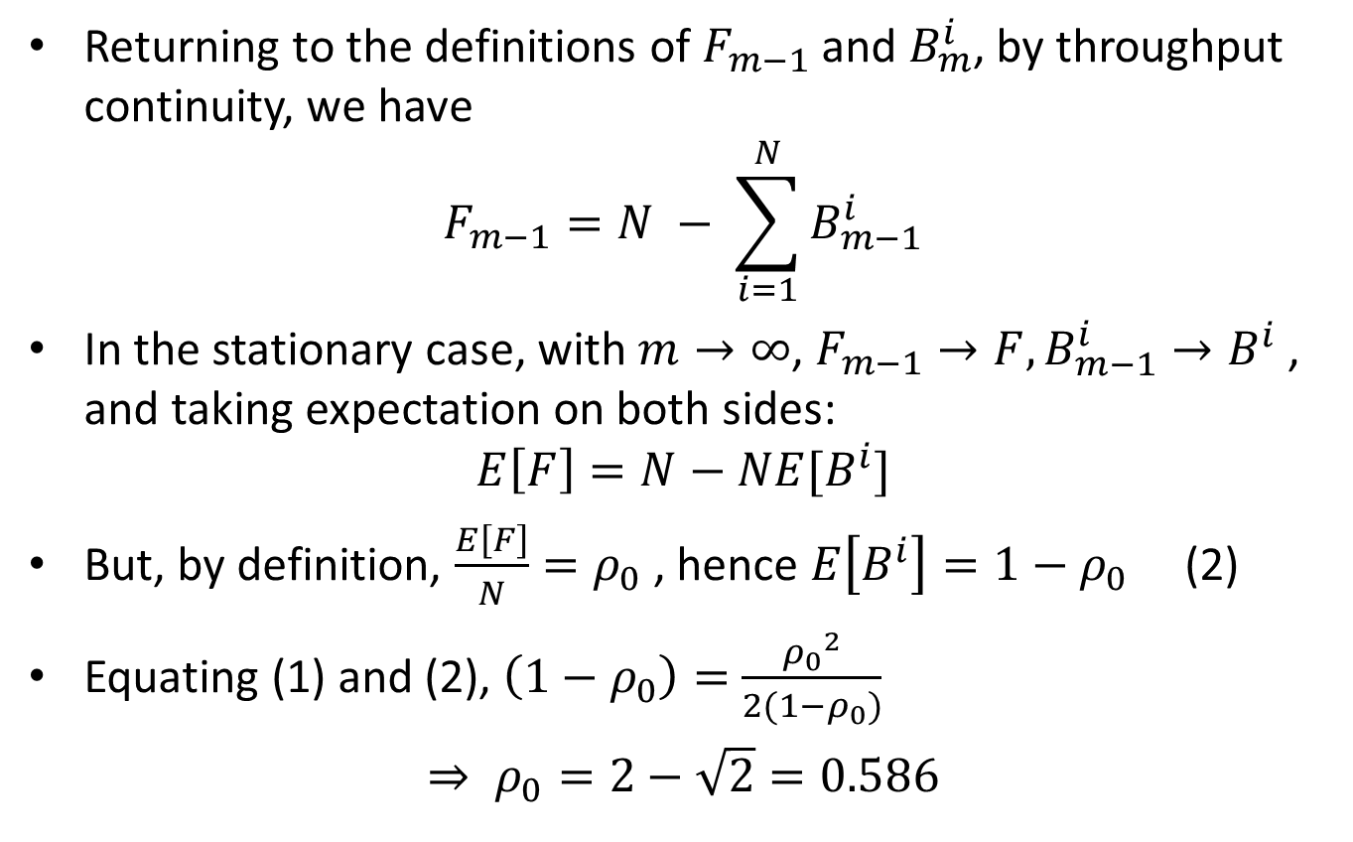
Returning to the definitions of $F_{m−1}$ and $B_{m}^{i}$, by throughput continuity, we have
$$F_{m−1}=N − \sum_{i=1}^{N}{B_{m−1}^{i}}$$
In the stationary case, with $m→∞$, $F_{m−1}→F, B_{m−1}^{i}→B^{i}$ , and taking expectation on both sides:
$$E\left[F\right]=N−NE[B^{i}]$$
But, by definition, $\frac{E\left[F\right]}{N}=ρ_{0}$ , hence $E\left[B^{i}\right]=1−ρ_{0}$ (2)
Equating (1) and (2), $\left(1−ρ_{0}\right)=$ $\frac{{ρ_{0}}^{2}}{2(1−ρ_{0})}$
$⇒ ρ_{0}=2−\sqrt{2}=0.586$

Slide 37
Outline
Overview
Switching Fabrics
Buffering Approaches
Throughput Performance
Scheduling

Slide 38
Output ports
datagram
buffer
queueing
switch
fabric
link
layer
protocol
(send)
line
termination
Datagram (packets) can be lost due to congestion, lack of buffers
buffering required when datagrams arrive from fabric faster than the transmission rate
scheduling discipline chooses among queued datagrams for transmission
Priority scheduling – who gets best performance, network neutrality

Slide 39
Scheduling mechanisms
scheduling: choose next packet to send on link
FIFO (first in first out) scheduling: send in order of arrival to queue
real-world example?
discard policy: if packet arrives to full queue: who to discard?
tail drop: drop arriving packet
priority: drop/remove on priority basis
random: drop/remove randomly
packet
arrivals
packet
departures
queue
(waiting area)
link
(server)

Slide 40
Scheduling policies: priority
priority scheduling: send highest priority queued packet
multiple classes, with different priorities
class may depend on marking or other header info, e.g. IP source/dest, port numbers, etc.
real world example?
high priority queue
(waiting area)
arrivals
departures
classify
link
(server)
low priority queue
(waiting area)
2
1
3
4
5
arrivals
packet in service
1
3
2
4
5
departures
1
3
2
4
5

Slide 41
Scheduling policies: still more
Round Robin (RR) scheduling:
multiple classes
cyclically scan class queues, sending one complete packet from each class (if available)
2
1
3
4
5
arrivals
packet in service
1
3
2
4
5
departures
1
3
2
4
5

Slide 42
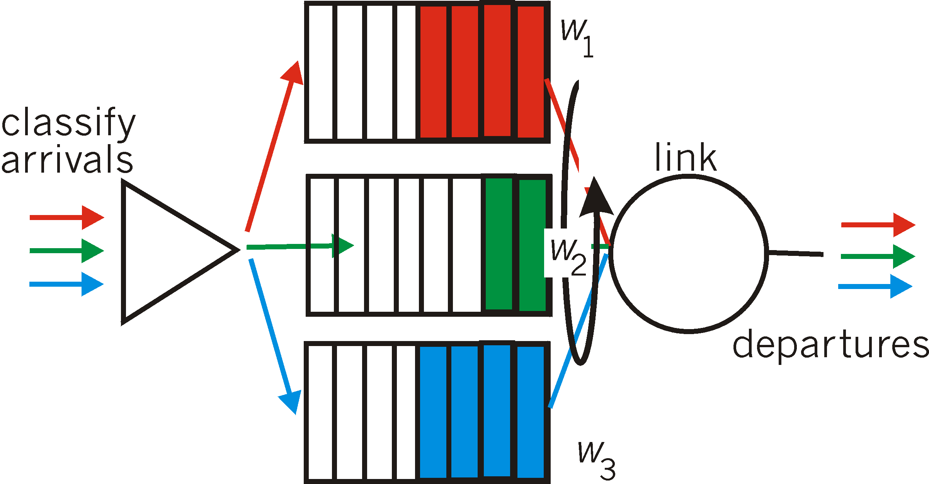
Scheduling policies: still more
Weighted Fair Queuing (WFQ):
generalized Round Robin
each class gets weighted amount of service in each cycle

